Slide 1

KARPAGAM INSTITUTE OF TECHNOLOGY, COIMBATORE. (Approved by AICTE and Affiliated to Anna University) ( Accredited by NBA(CSE,IT,ECE)
BATCH NO – 13
SCAM LINK DETECTION
Guide Name: | Presented By:
Dr.M.SATHIYA.,M.E.,Ph.D | Dinakaran.M
Associate Professor, | Dinesh.R
Karpagam Institute of Technology, | Karan.S
Coimbatore -641105 | Kaviarasan.P
DEPARTMENT OF INFORMATION TECHNOLOGY

Slide 2
ABSTRACT
Scamming is one of the cyber attack methods that simulate a regular website to trick users into providing personal information.
Unfortunately, there is no effective technology that can completely prevent phishing attacks.
With the rapid development of Machine Learning(ML), there are more and more applications in the field of cybersecurity.
This project proposes scam a Machine Learning(ML) framework that uses Predictive Attention Model with Gradient Boosting Classifier(GBC) to detect phishing links in a real-time web browsing environment using URL and HTML features.
Some solutions are based on the features extracted by rules, and some of the features need to rely on third-party services, which will cause instability and time-consuming issues in the prediction service.
Phishing detection is a binary classification task that contains two classes: legitimate and phishing.

Slide 3
PROBLEM STATEMENT
Phishing URL and website detection can be challenging due to the constantly evolving tactics used by phishers to make their attacks more convincing and difficult to detect.
Attacks can be designed to exploit human weaknesses such as curiosity, urgency, or fear to trick users into clicking on a link or entering their sensitive information.
URL and website detection tools can sometimes generate false positives, which means that legitimate URLs or websites are incorrectly flagged as phishing sites, leading to inconvenience and frustration for users.
Phishing techniques and tactics change rapidly, making it crucial for the system to adapt and learn from emerging patterns and trends. The solution should be capable of updating its knowledge base regularly to stay up to date with the latest phishing techniques, incorporating machine learning to improve accuracy over time.
Phishing attacks are constantly evolving, requiring the system to detect new phishing websites promptly. The solution should be able to analyse and classify websites in real-time, minimizing the response time between the creation of a phishing website and its detection.

Slide 4
EXISTING SYSTEM
In existing system supervised learning algorithm has been implemented machine learning based algorithm has been implemented KNN (k nearest neighbor) has been implemented.
Web pages not by their content but using their URLs, which is much faster as no delays are incurred in fetching the page content or parsing the text. The URL was segmented into multiple tokens from which classification features were extracted. The features modeled sequential dependencies between tokens.
To the fact, that the combination of high-quality URL segmentation and feature extraction improved the classification rate over several baseline techniques.
They trained separate binary classifiers for each topic (student, faculty, course and project) and were able to improve over the best reported F-measure.

Slide 5
PROPOSED SYSTEM
This project proposes a machine learning-based framework to detect scam links in a real-time web browsing environment.
Users can open their browser and input the URL into Phish Detection, which predicts and blocks the URL if it is identified as a phishing website.
Develop a browser plug-in to receive client information, call the background prediction service, block and show the prediction results to users.
A large dataset of URLs would need to be collected, including both phishing and legitimate websites. This dataset would be used to train and evaluate the machine learning models
Relevant features from the URLs would need to be extracted to represent the URLs as input for the machine learning models. Features could include domain length, presence of special characters, presence of numbers, URL length, and other relevant features that can help in distinguishing between phishing and legitimate URLs..

Slide 6
MODULE LIST
Dataset collection
The dataset is borrowed from http://www.kaggle.com/eswarchandt/phishing-website-detector. A collection of website URLs for 11000+ websites. Each sample has 30 website parameters and a class label identifying it as a phishing website or not . Overview of the dataset is , it 11054 samples with 32 features
Familiarizing with Data & EDA
Exploratory data analysis (EDA) is used by data scientists to analyze and investigate data sets and summarize their main characteristics, often employing data visualization methods.
EDA techniques allow for effective manipulation of data sources, enabling data scientists to find the answers they need by discovering data patterns, spotting anomalies, checking assumptions, or testing a hypothesis
Exploratory Data Analysis (EDA) is a process of describing the data by means of statistical and visualization techniques in order to bring important aspects of that data into focus for further analysis.

Slide 7
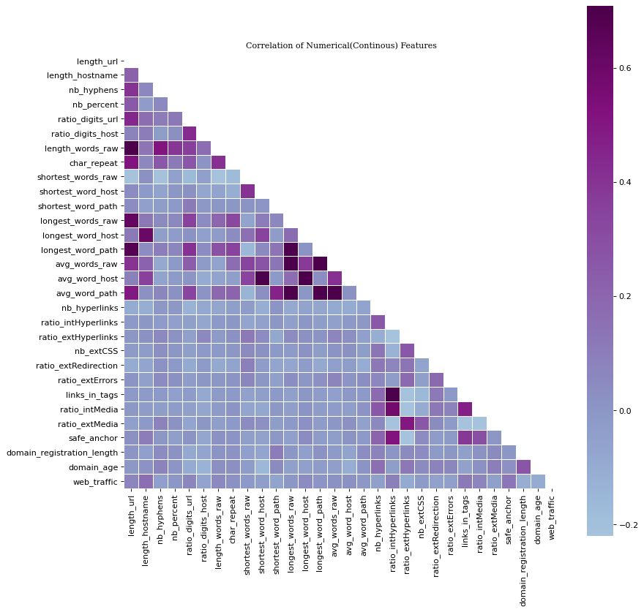
kl
Visualizing the data
Data visualization is the representation of data through use of common graphics, such as charts, plots, info graphics, and even animations. These visual displays of information communicate complex data relationships and data-driven insights in a way that is easy to understand.

Slide 8
j
Splitting the data
Data splitting is when data is divided into two or more subsets. Typically, with a two-part split, one part is used to evaluate or test the data and the other to train the model. Data splitting is an important aspect of data science, particularly for creating models based on data.
Training the data model
Supervised machine learning is one of the most commonly used and successful types of machine learning. Supervised learning is used whenever we want to predict a certain outcome/label from a given set of features, and we have examples of features-label pairs. We build a machine learning model from these features-label pairs, which comprise our training set.
There are two major types of supervised machine learning problems, called classification and regression. Our data set comes under regression problem, as the prediction of suicide rate is a continuous number, or a floating-point number in programming terms.

Slide 9
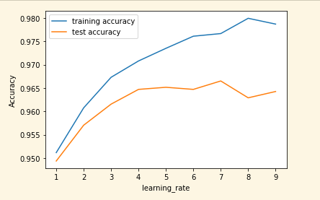
l
Gradient Boosting Classifiers
Gradient Boosting Classifiers(GBC) are a group of machine learning algorithm that combine many learning models together to create a strong predictive model. Decision trees are usually used when doing gradient boosting . Boosting algorithm play a crucial role in dealing with bias variance trade-off. Unlike bagging algorithm, which only control for high variance in a model.

Slide 10




PROCESS DIAGRAM
Attacker
System Developer
Upload Phishing Dataset
Preprocessing
Phishing Web Application
Feature Extraction
Classification
Inject Phishing URL
Train & Build Model
Track History
Request URL or Web Site
Open browser
Phish URL Prediction
Activate Phishing
Phishing
Register\Login
Block URL
Block Msg
Legitimate
Response URL or Website
System User

Slide 11
DATA FLOW DIAGRAM
User
Open browser
Configuration System or Laptop
Request URL
Register & Login
Upload Phishing Dataset
Train Phishing Model
Scam Detection Web Application
URL Scan
System Developer
User System
Load & Explore Dataset
Inject Phishing URL or Website
Phishing Predictor engine
Preprocessing
Feature Selection
Attacker
Feature Extraction
Classification
Train & Build the Model
Predict Phishing & Type
Notify and Visualize
Phishing DB

Slide 12
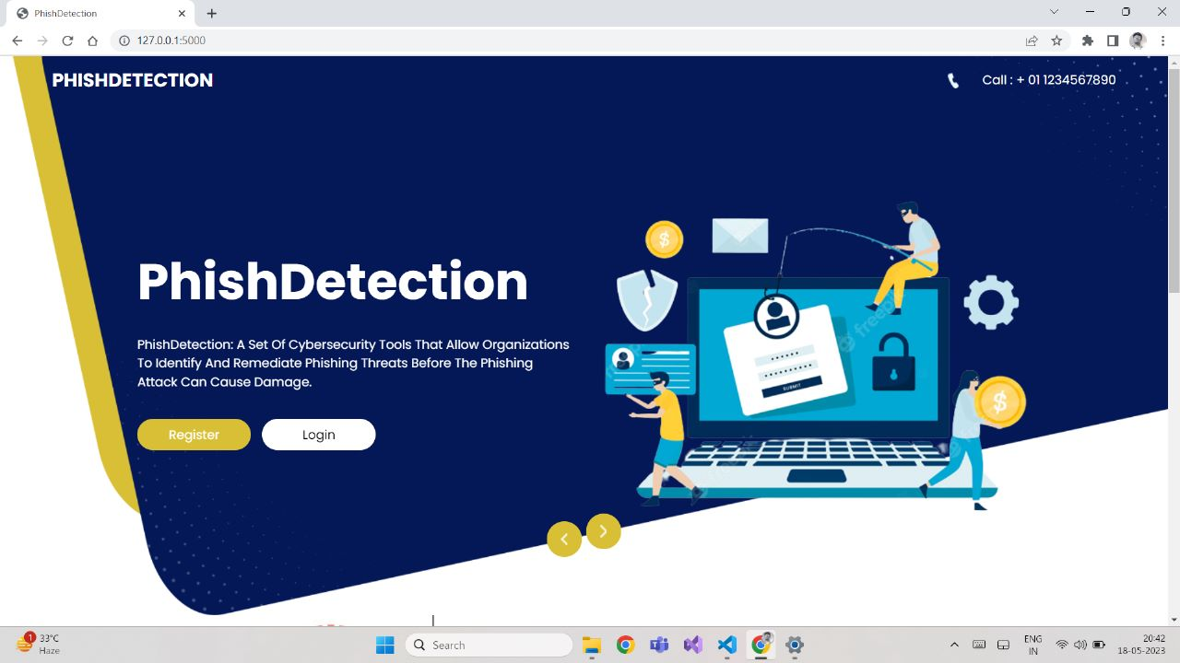
OUTPUT
INDEX PAGE :

Slide 13
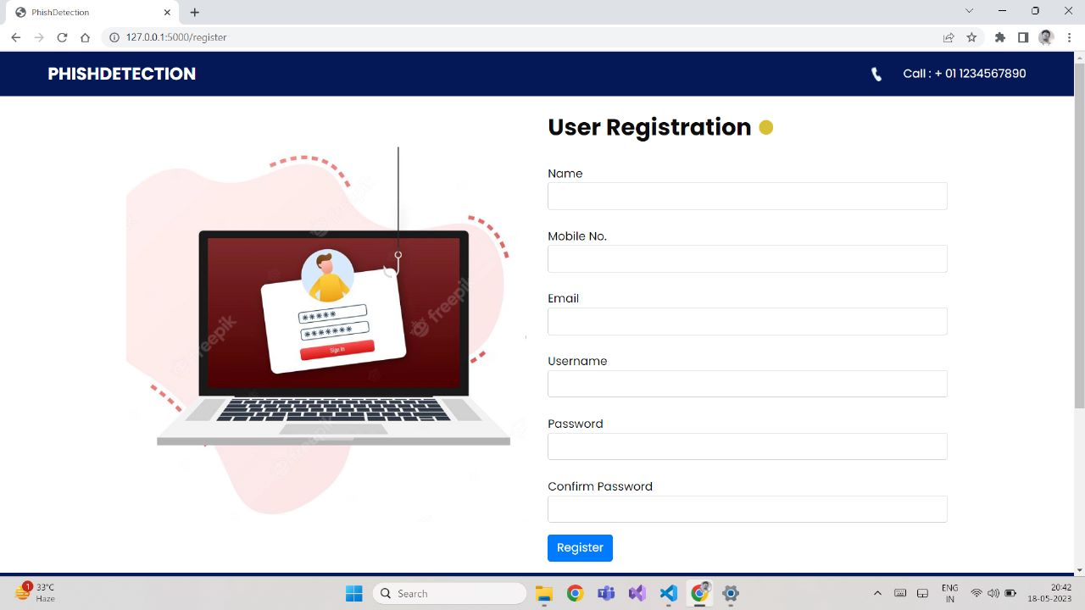
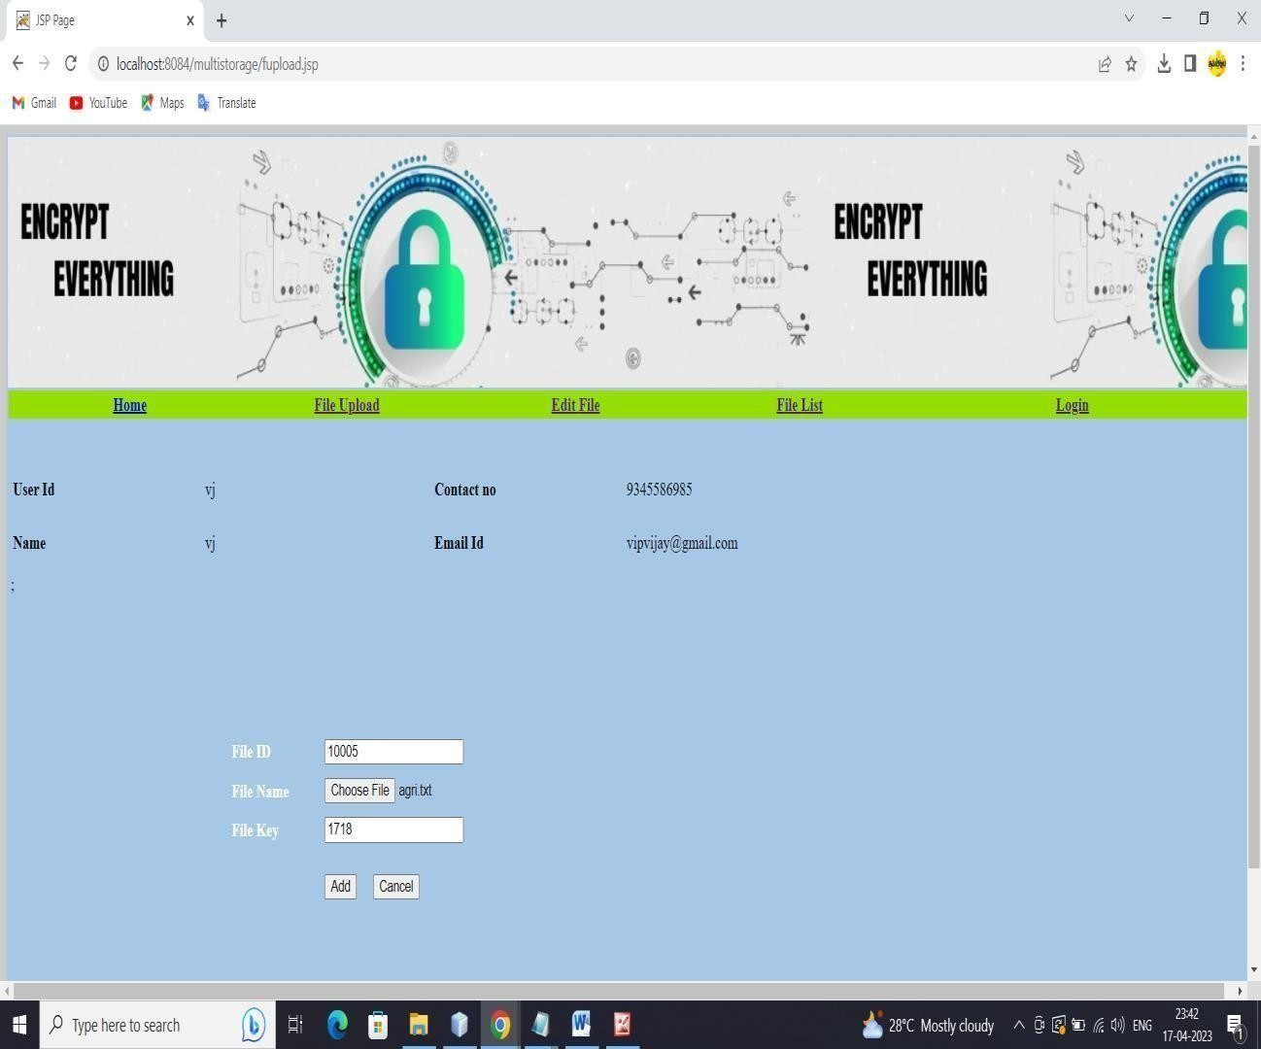
REGISTER PAGE :

Slide 14
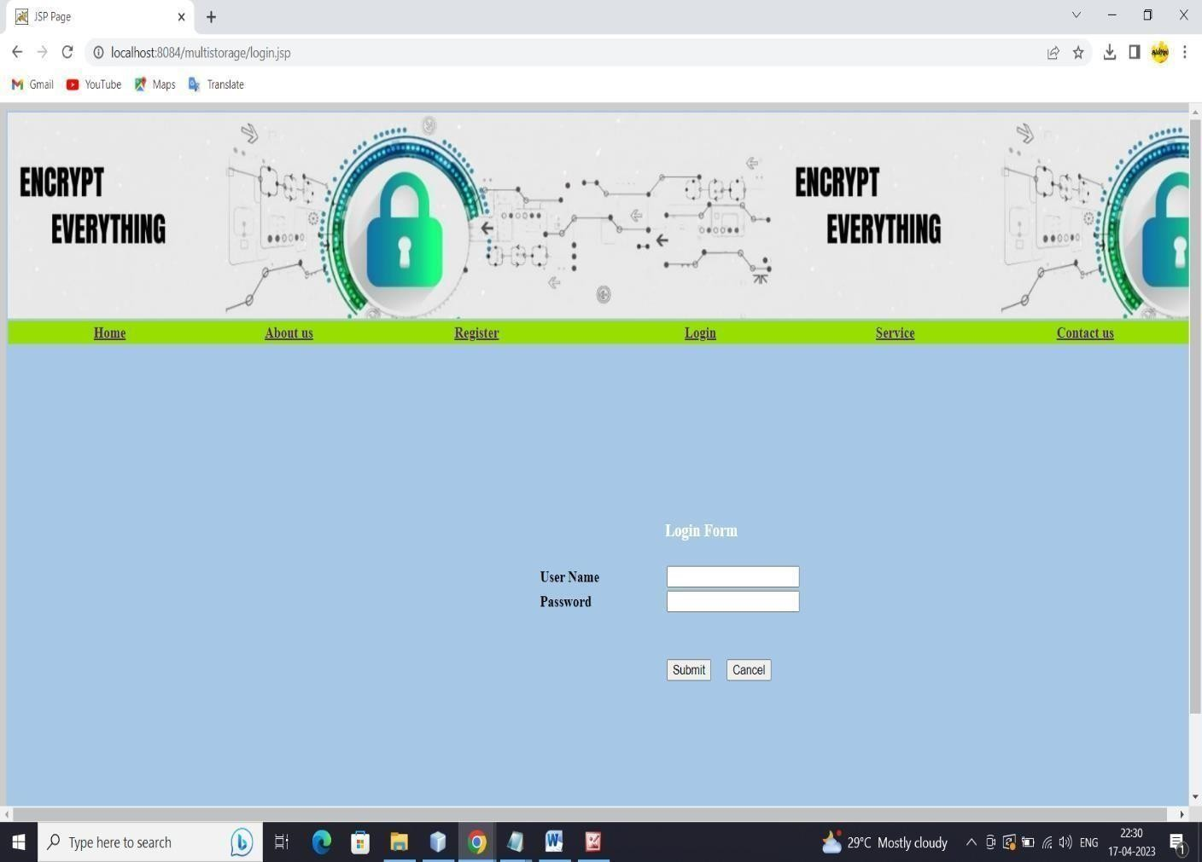
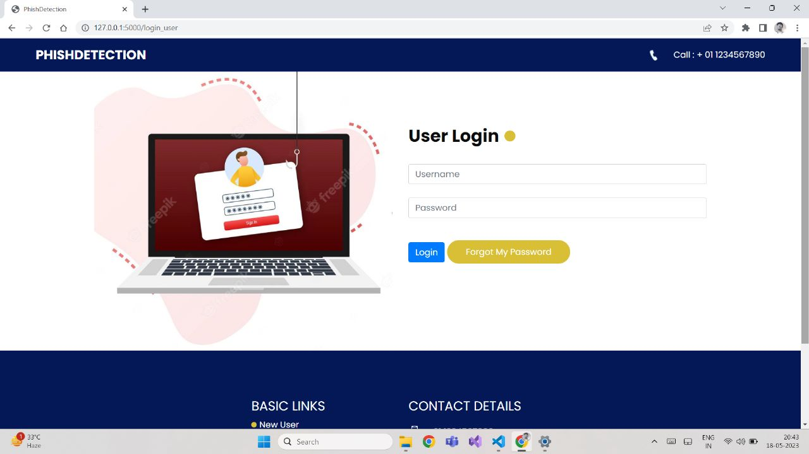
LOGIN PAGE :

Slide 15
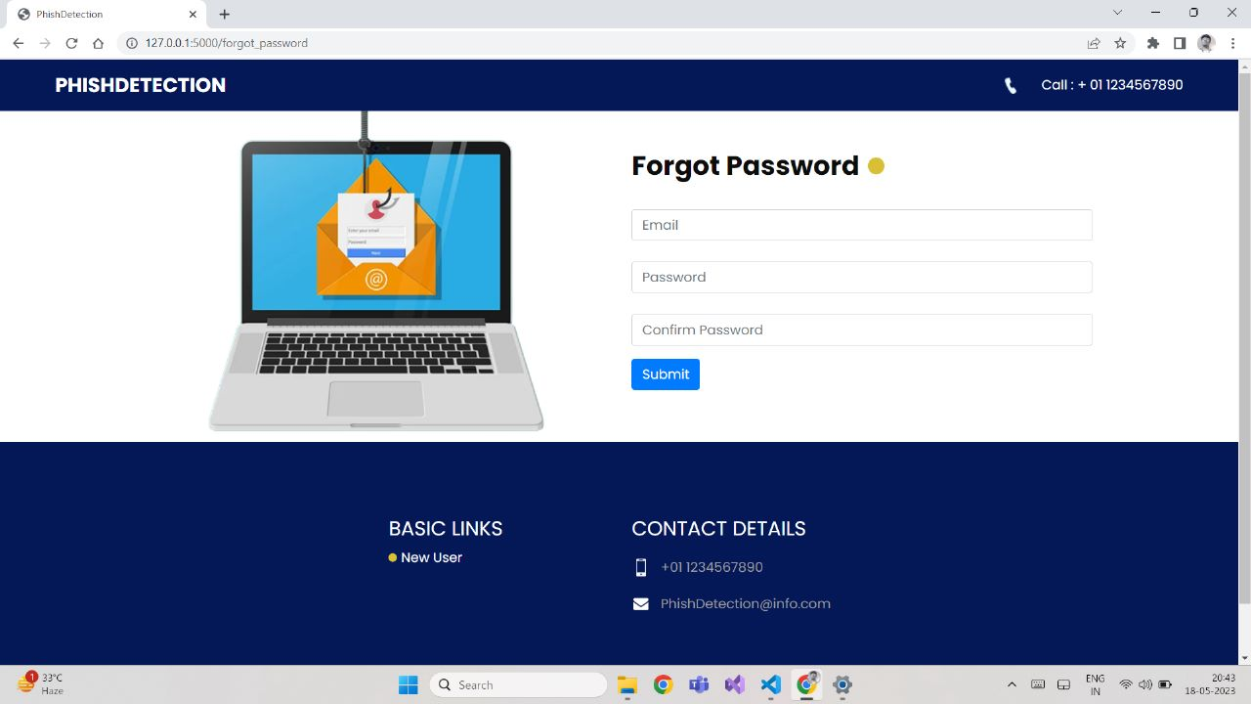
FORGOT PASSWORD PAGE :

Slide 16
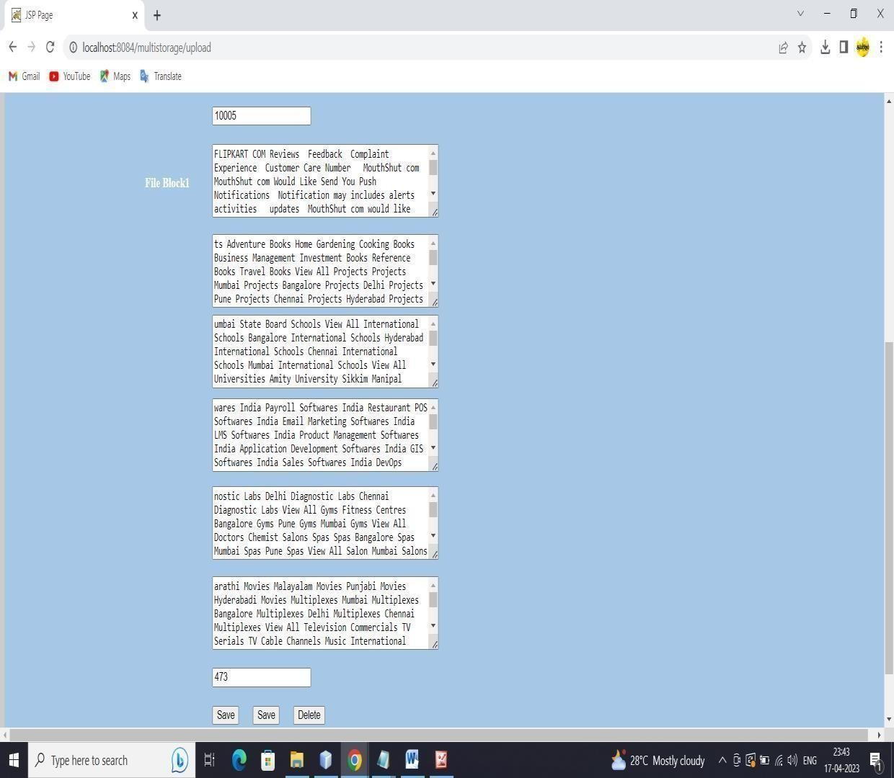
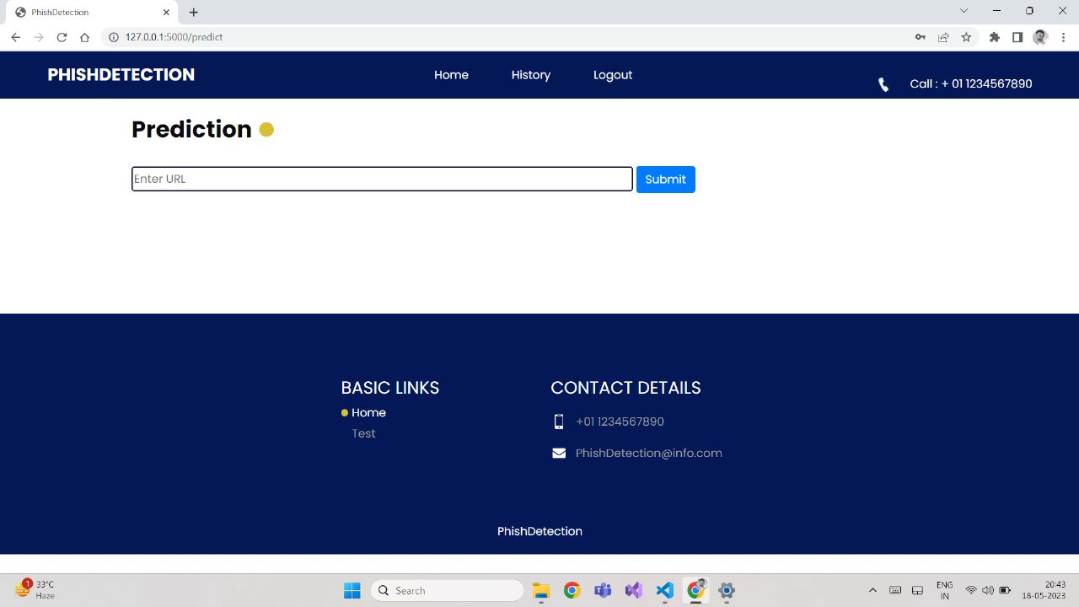
URL PREDICTION PAGE :

Slide 17
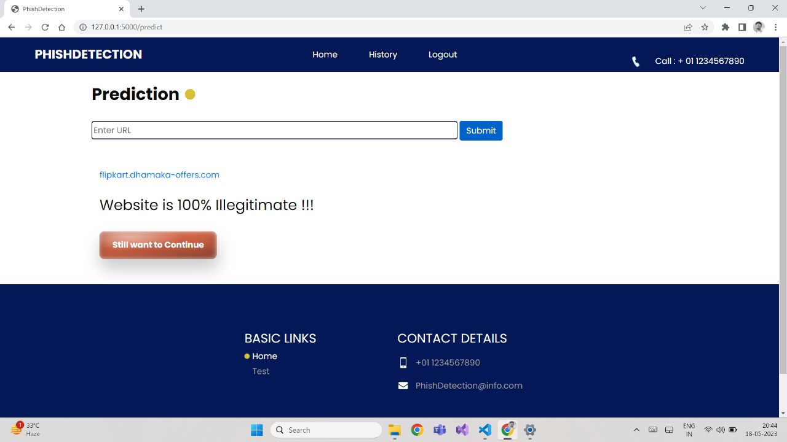
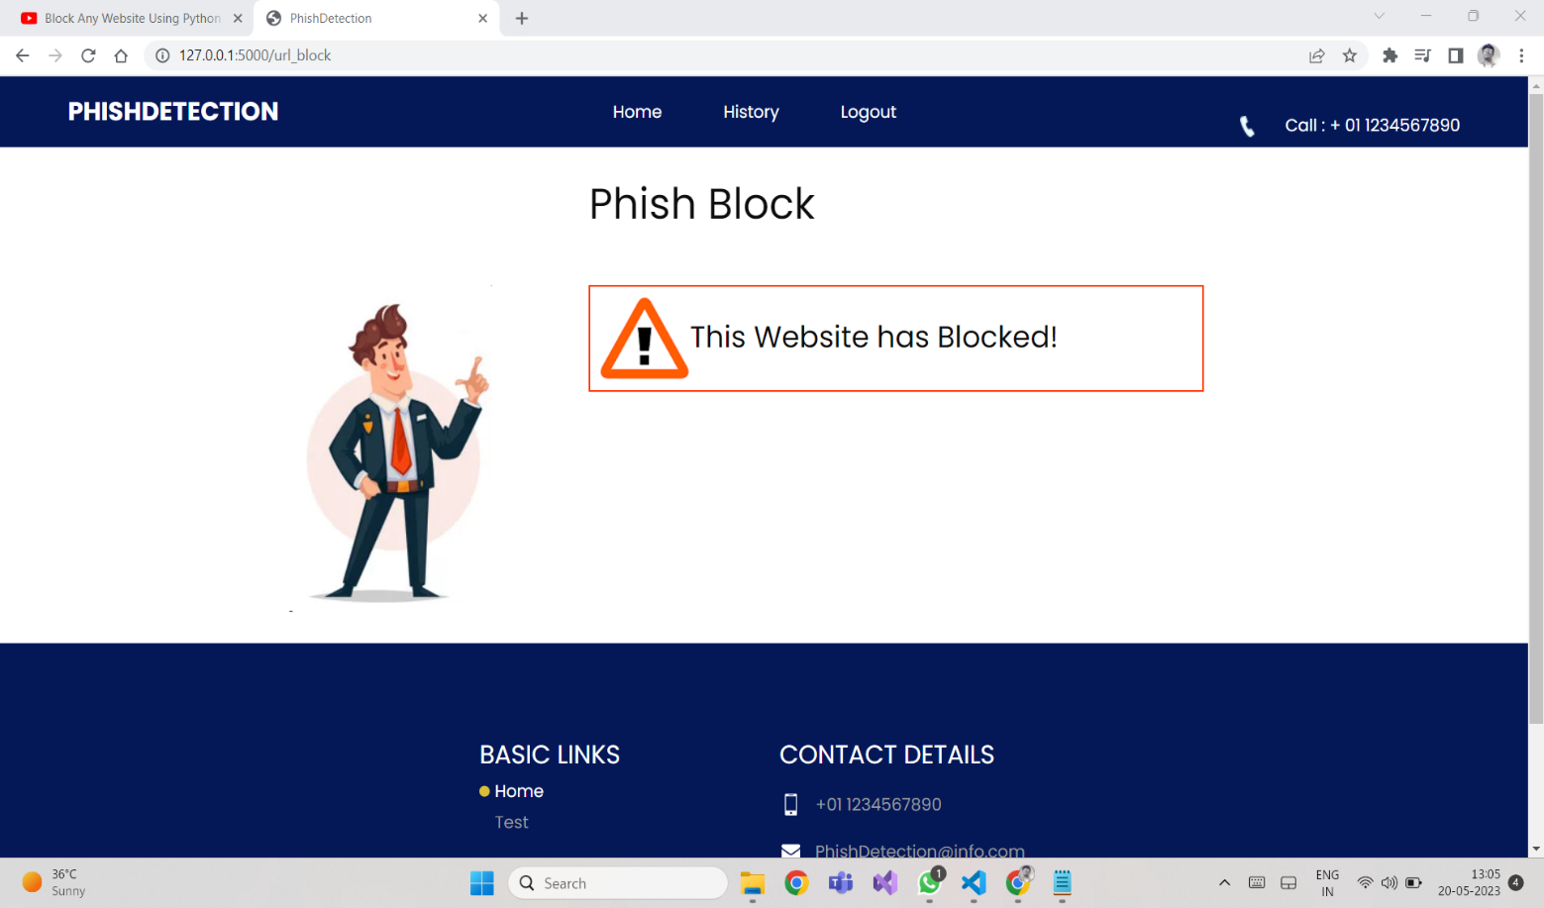
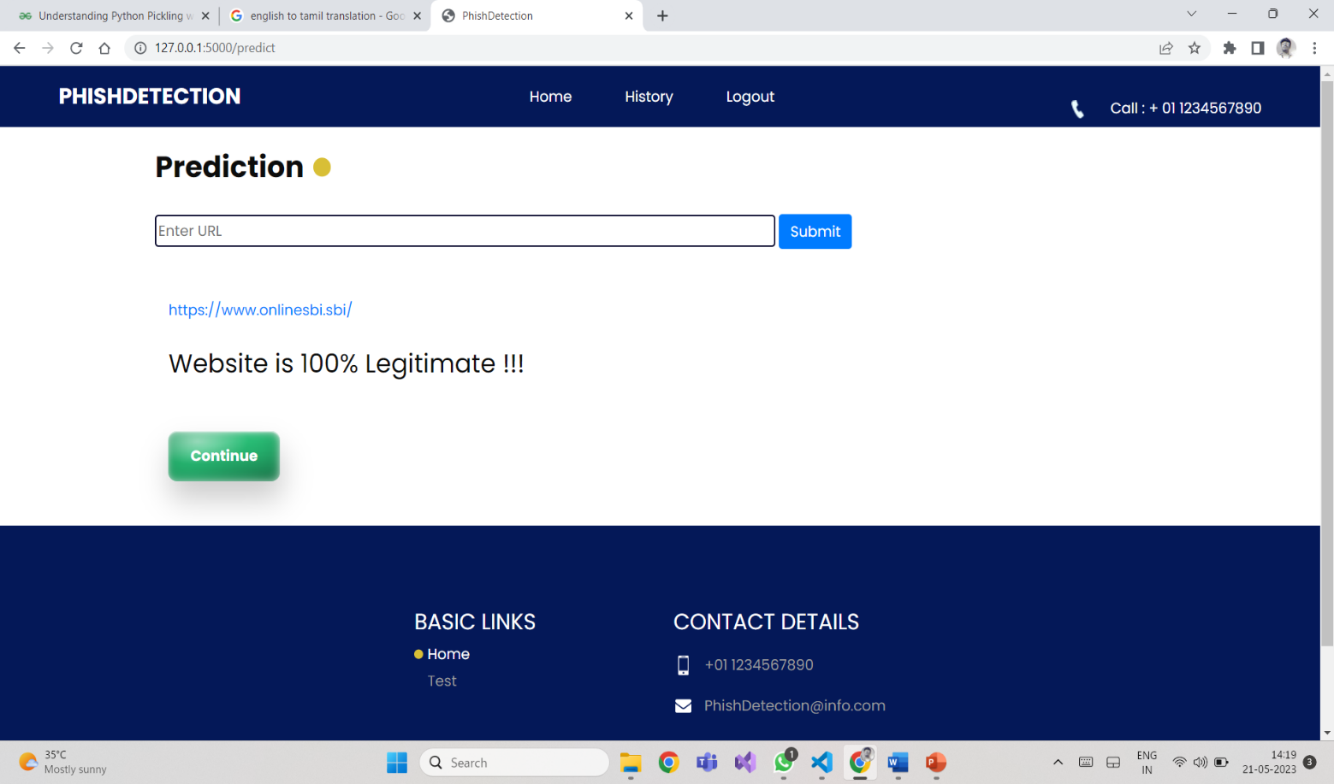
LEGITIMATE URL PREDICTION :

Slide 18
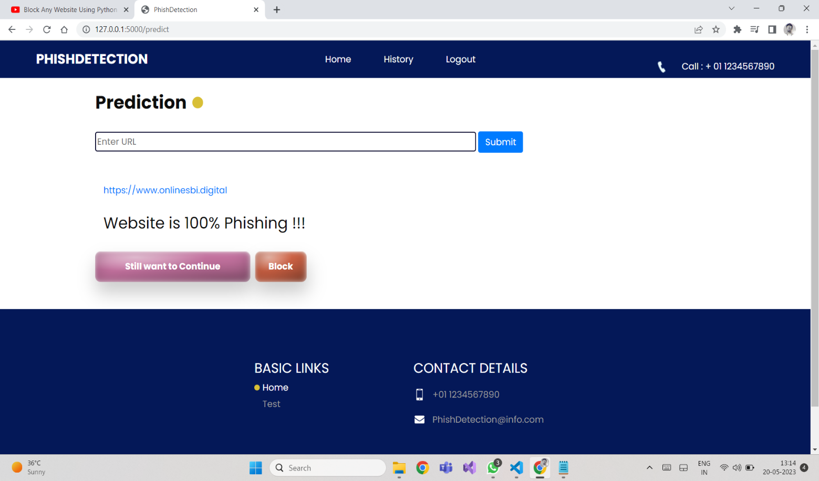
PHISHING URL PREDICTION :

Slide 19
PHISHING URL BLOCK :

Slide 20
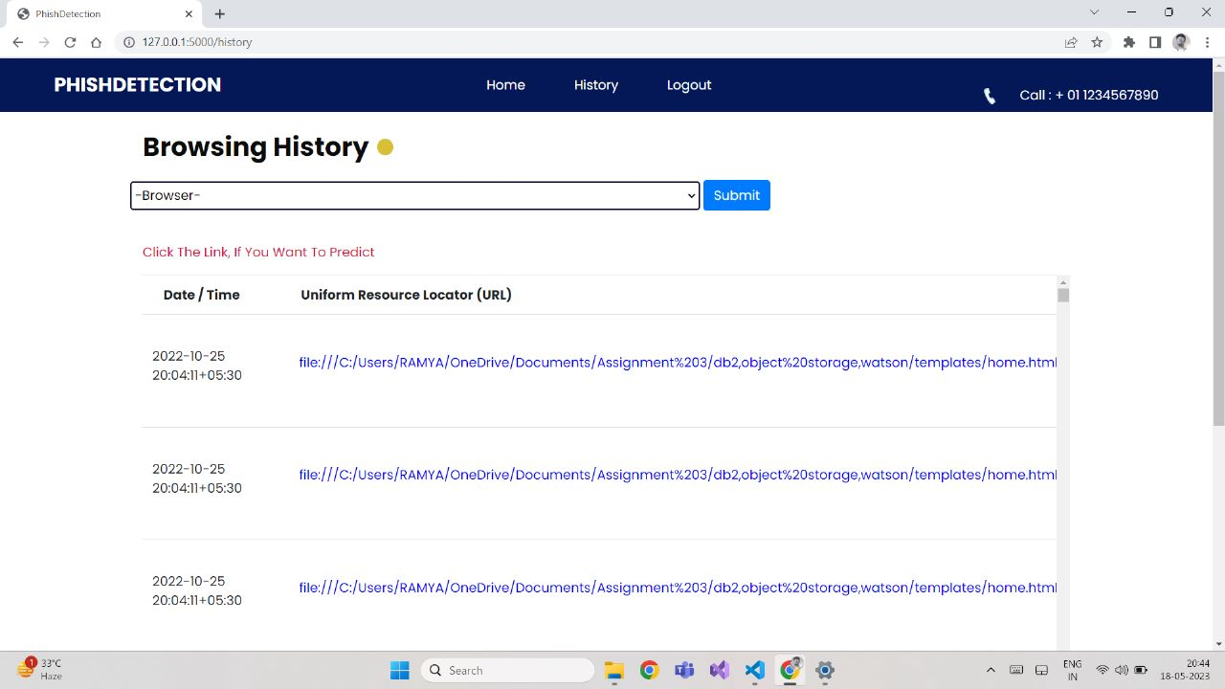
BROWSING HISTORY PAGE :

Slide 21
CONCLUSION
The final take away form this project is to explore various machine learning models, perform Exploratory Data Analysis(EDA) on phishing dataset and understanding their features.
Creating this notebook helped me to learn a lot about the features affecting the models to detect whether URL is safe or not, also I came to know how to tuned model and how they affect the model performance.
The final conclusion on the phishing dataset is that the some feature like "HTTPS", "Anchor URL", "Website Traffic" have more importance to classify URL is phishing URL or not.
Gradient Boosting Classifier(GBC) classify URL is 97.4% respective classes and hence reduces the chance of malicious attachments.
In conclusion, the paper highlights the importance of using URL-based features for phishing website detection and the potential for integrating machine learning techniques for enhanced classification accuracy.

Slide 22
REFERENCE
Alazab, Mamoun, and Sitalakshmi Venkatraman. "Phishing websites detection based on machine learning techniques." International Journal of Computer Applications 179.24 (2020): 6-12.
Jaiswal, A. K., Mishra, S. K., & Tyagi, S. (2020). A study of machine learning-based approaches for phishing website detection. International Journal of Computer Science and Information Security, 18(9), 51-57.
Choudhary A., Kumar, R., & Jaiswal A. (2020). Machine Learning-based Approach for Phishing URL Detection. International Journal of Computer Applications, 178(17), 1-6
Xu, Tian, and Zheng Yan. "Detecting Phishing Websites Using Machine Learning Techniques." Handbook of Research on Machine Learning Applications and Trends: Algorithms, Methods, and Techniques (2021): 404-419
Yadav, A., & Singh, V. K. (2021). Machine Learning-Based Approach for Phishing Website Detection. In Proceedings of the International Conference on Smart Computing and Informatics (pp. 53-63). Springer.

